Slide 1
User Stories: Recipe Generator
Group 8:
Jack Hudson, Shivansh Soni, Daniel Trainor, Lord Custodio

Slide 2

A web application that allows users to generate recipes based on ingredients, macronutrients, or dietary preferences.
Notes:
We are to make a web-based recipe generator that allows the client to input ingredients and/or macros that they have and it will output recipes from the internet and internal recipe database that only include those parameters.

Slide 3

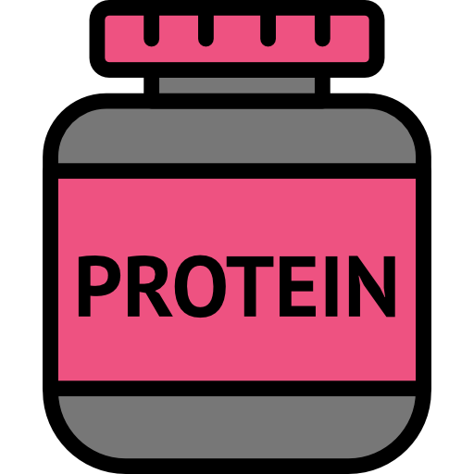
Main Feature – Recipe Generation
Input
Specific ingredients
Macronutrient preferences
User allergies & dietary preferences
Output
Recipes from internet/APIs
Recipes from internal recipe database
Notes:
This generator will allow the user to filter using tags to search with dietary restrictions in mind and/or macronutrients, fats, carbs, etc. The generator will also allow the user to create or edit recipes already stored in the site; and have a rating system to show others their thoughts on a recipe. This will overall allow the user to generate a cooking/meal plan of the week that shows what recipes they will cook and for what time each day, depending on the tags and ingredients they input.

Slide 4


Key features
Ingredient and macro-based search
Customizable filtering options (dietary restrictions, carbs, fats, etc.)
Recipe creation and editing
Meal planning system
Rating and feedback system
Notes:
We can search for recipes using constraints such as ingredients, dietary preferences, health conditions
The user is allowed to create their own recipes and edit existing ones that they have saved
The user can rate the recipes recommended to them out of 5 stars

Slide 5
Use Case 1:
Recipe Generation
This algorithm will generate recipes based on the parameters set by the user. It will output comprehensive cooking recipes so that the user is informed what, when, and why they are going to cook.
Goal: A user looking for recipe suggestions to create a week cooking plan.
Pre-condition: The user has to have their parameters set in their profile already, this includes dietary restrictions, allergens, etc.
Exception: The user manually selects recipes from the database and doesn’t use the recipe generator
Trigger: The user navigates to the generation tab and asks the program to generate recipes for the meal, day, week, ect
Main success scenario: The program outputs recipe suggestions for each day of the week, depending on the parameters set by the user
Error scenario: The program outputs recipes that aren’t based on the parameters set by the user The program doesn’t output any recipe, The program crashes

Slide 6
Use Case 2- User Inputs Personal Information
Goal: The user interacts with the front end to input personal information relevant to the application. Must include weight, height, allergies, dietary preferences, health conditions, and other potentially useful details. The information is then sent and stored in a user database to be accessed in the future to create relevant suggestions
Pre/post conditions: An account has to have already been created
Exceptions: N/A, They must include this information for the algorithm to work
Trigger: The user went into their profile page to add more information about themselves
Main success scenario: User information stored to be used for future recipe queries (adds a “relevance factor” to the querying process)
Error scenarios: The page crashes or the user inputs the wrong format for the required type of data

Slide 7
Use Case 3- Personal Recipe Creation
Description: The user wants to add their own recipe to the recipe generation.
Actors: User
Goal: The user can successfully add a recipe full of ingredients, instructions, images, etc. to the database, for the ability for it to be used later on.
Pre/post conditions: The user has to have an account created
Exceptions: The user doesn’t want to add their own recipe
Trigger: The user navigates to the create recipe button on the recipe database
Main success scenario: The user curates a recipe and saves it to their viewable, editable, personal library (database) of recipes
Error scenarios: The user is unable to create their own recipe, or the user incorrectly inputs the wrong data format for the recipe required type, or the program crashes

Slide 8
Use Case 4- Save Preexisting Recipe
Description: The user wants to add a recipe to the recipe generation.
Actors: User
Goal: The user can successfully save a recipe full of ingredients, instructions, images, etc. to their personal database, for it to be used/edited later on.
Preconditions: The user has to have an account created, navigated to the library, algorithm already outputted
Exceptions: The user doesn’t want to save a given recipe
Trigger: The user clicks the save recipe button
Main success scenario: The user saves it to their viewable, editable, personal library (database) of recipes
Error scenarios: The user is unable to save the recipe, or the program crashes

